Slide 1



Quantum Financial Forecasting
Alex, Florian, Leonard, Mohamad

Slide 2
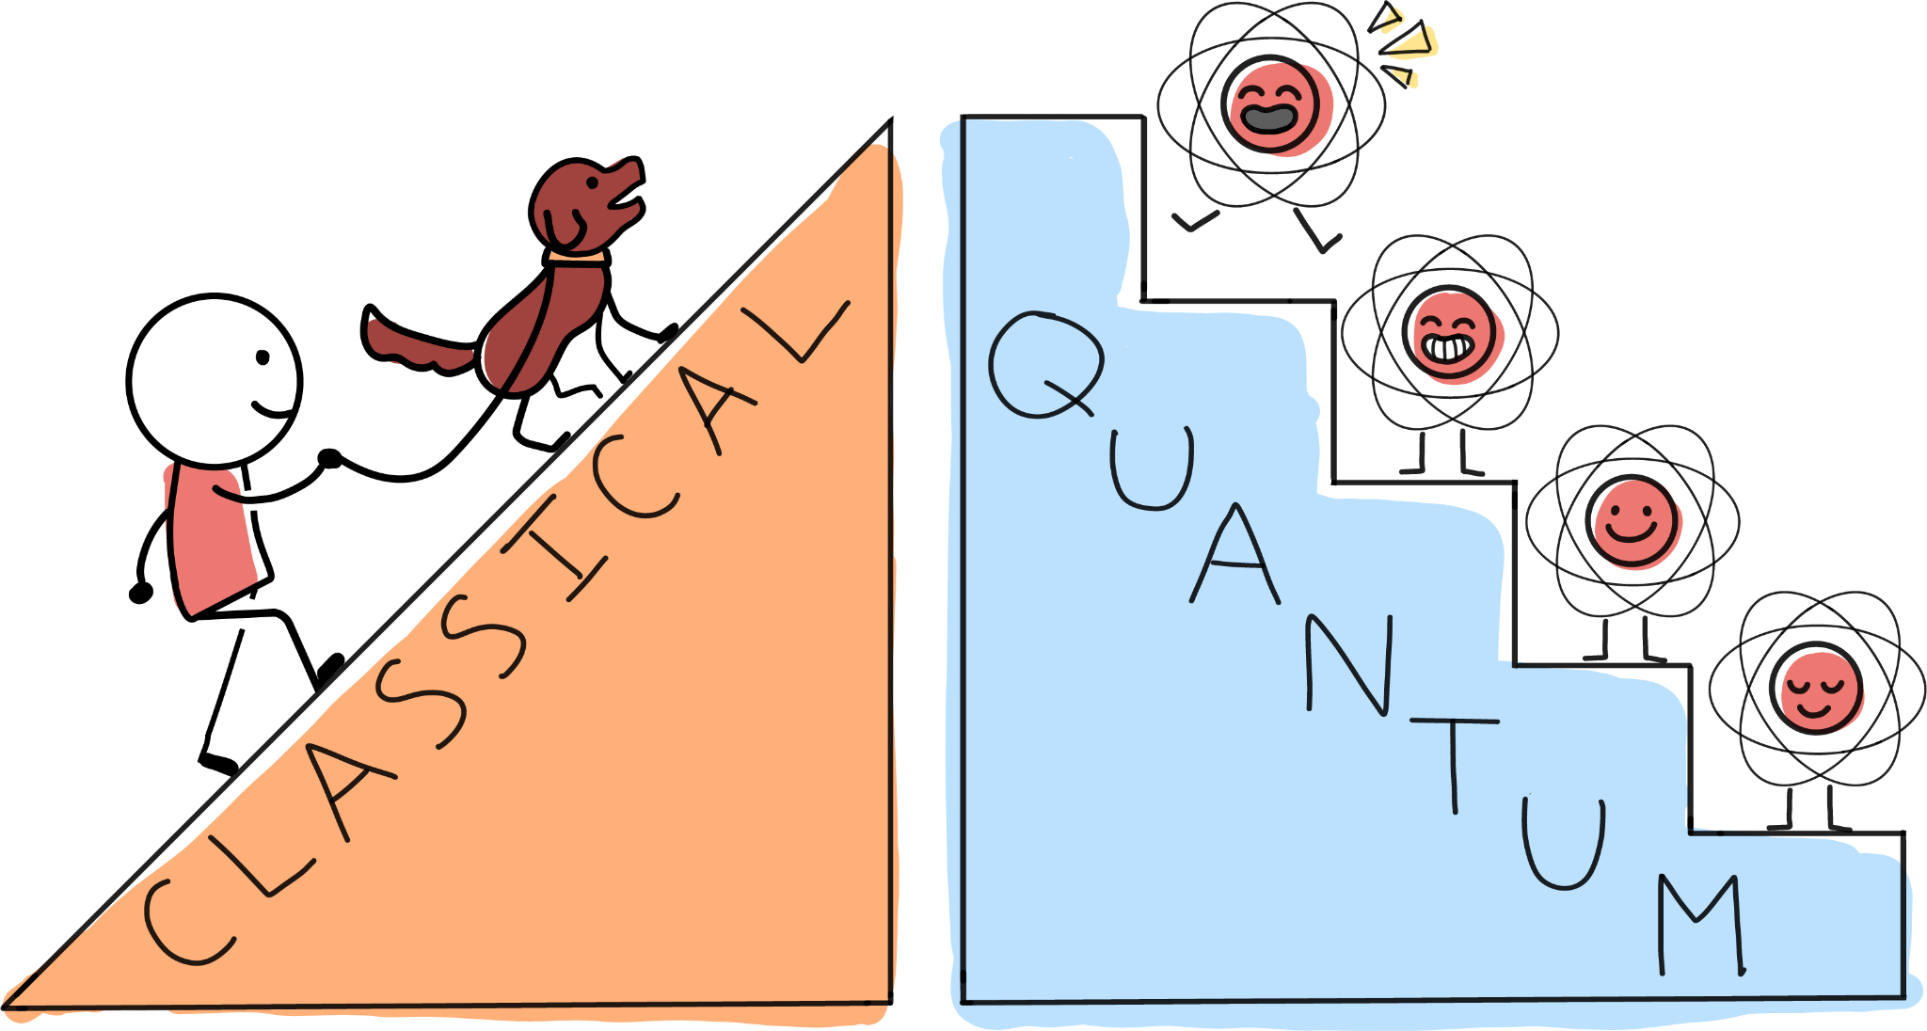
Agenda from last Milestone
Collect and prepare stocks datasets from AlphaVantage
Simple Quantum Neural Network with Pennylane
Testing on different mathematical Curves
Compare to classical NN with a similar number of parameters
Quantum Recurrent Neural Network
Compare QRNN with classical RNN
Outlook:
Quantum LSTM
Hyperparameter Optimization (e.g. Learning Rate)
Different quantum circuit architectures
Quantum Financial Forecasting

Slide 3
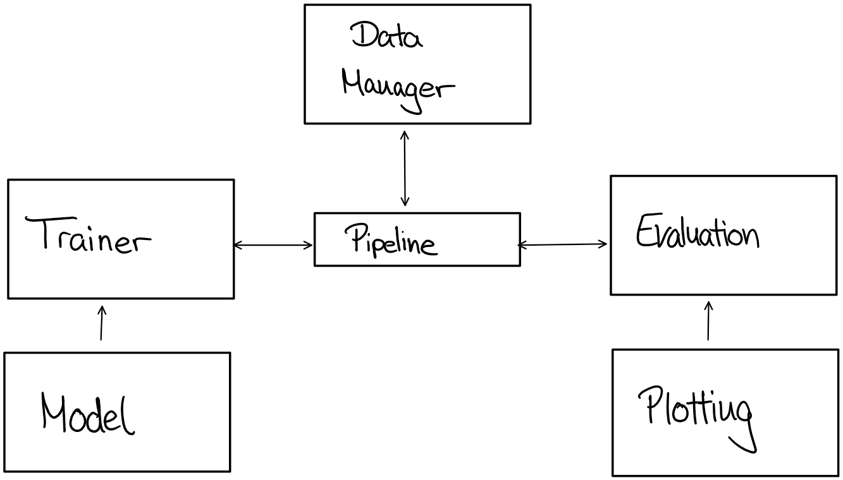
Structure of Time Series Forecaster
Quantum Financial Forecasting

Slide 4
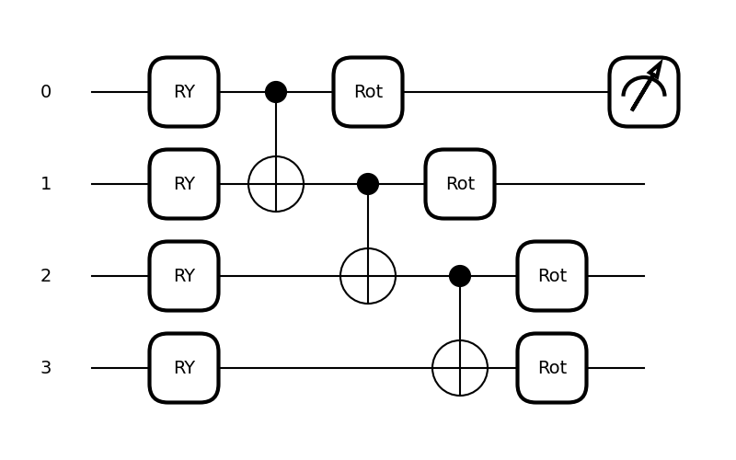
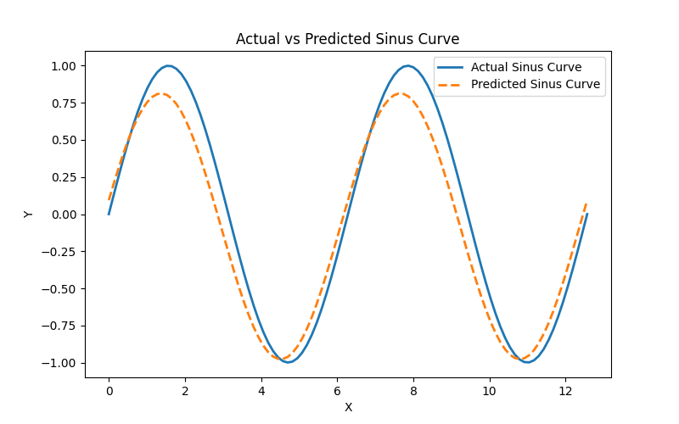
Simple QNN
Variational Quantum Circuit (Pennylane)
Quantum Financial Forecasting

Slide 5
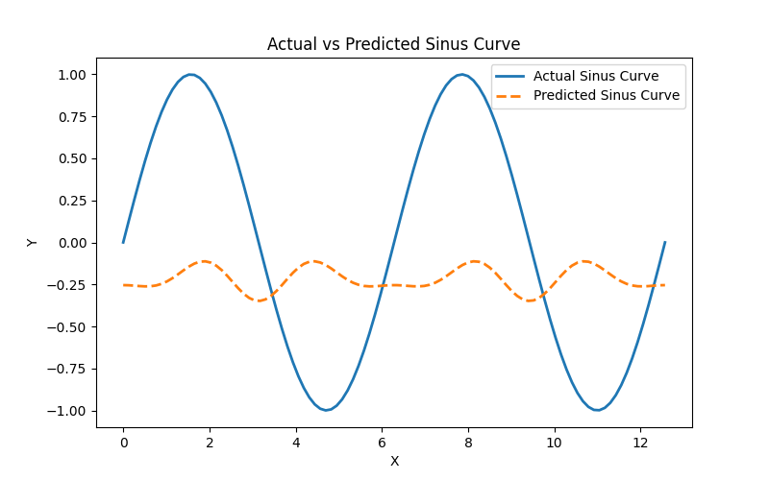
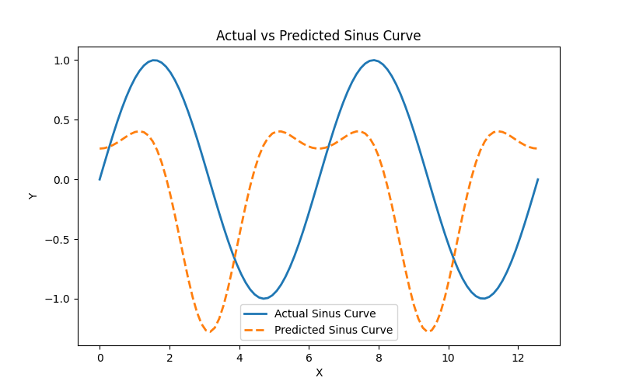
Simple QNN
Not all results were that accurate
Quantum Financial Forecasting

Slide 6
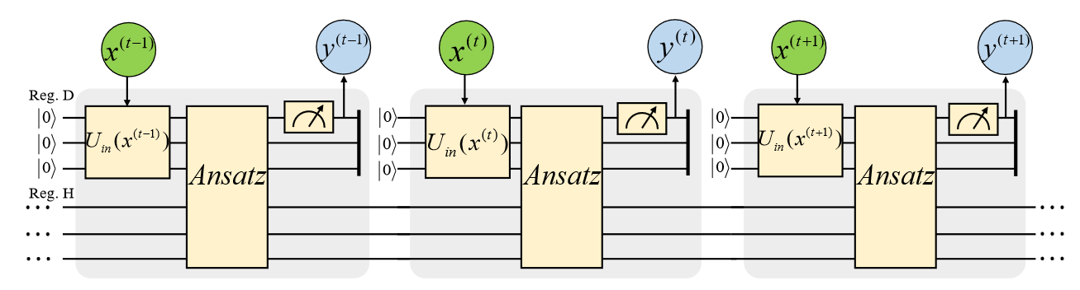
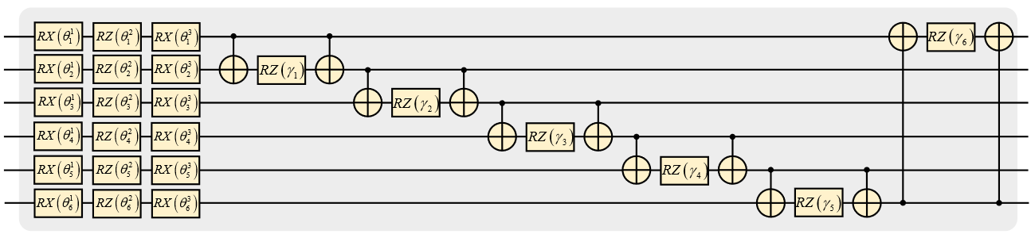
QRNN
Quantum Financial Forecasting

Slide 7
QLSTM
Quantum LTSM structure similar to the classical implementation of LSTM
Prevents vanishing/exploding gradient problem from QRNN
Circuit structure (input, output, forget, update)
Data encoding (batch size, sequence length, feature size)
Implementation status:
In progress
TRAIN
TEST
TRAIN
TEST
TRAIN
TEST
Quantum Financial Forecasting

Slide 8
Outlook
Transition from mathematical functions to stock data
Optimization of parameters (batch size, layers, learning rate, etc.)
Model performance on different stocks
Input encoding with more data (e.g. technical indicators)
Deploying autoencoder to the quantum models
Analyze different possible quantum structures
Quantum Financial Forecasting

